Slide 1
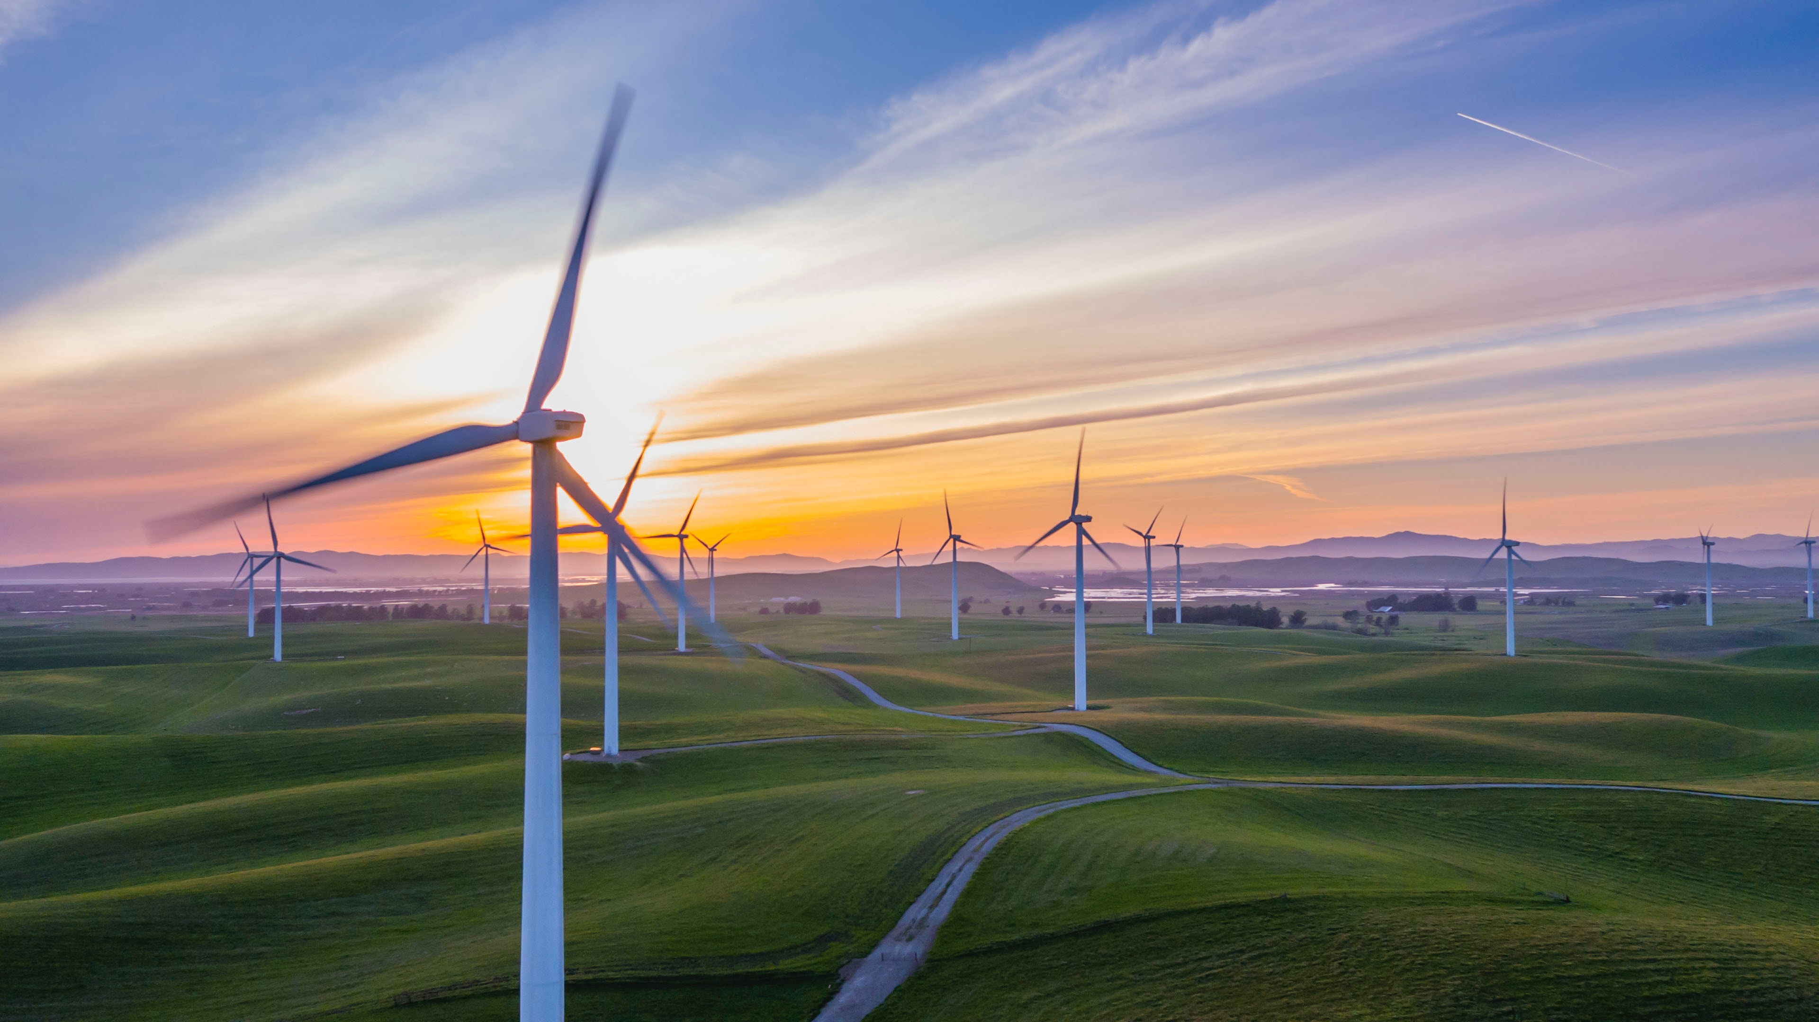
Wind power

Slide 2
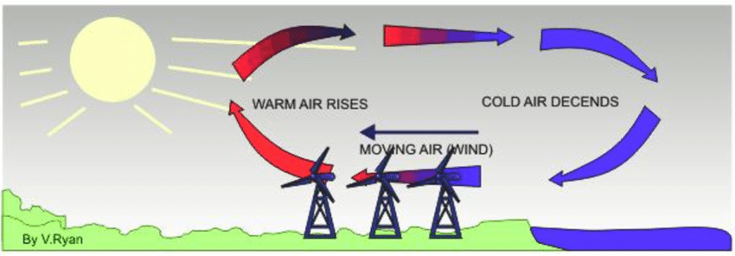
- uneven heating of atmosphere by sun
- air is heated up by sun —> rises
- produces area of low pressure
- cooler air moves in under hot air
- this patters on air movement causes wind
What causes wind?

Slide 3
- wind moves blades (kinetic NRG doing work)
- blades attached to large gear (work is done to move gear)
- Gear spins turbine —> generates electricity (converts kinetic energy into stored energy)
- energy neither created nor destroyed so energy is converted from one form to another
- main idea behind all energy sources
Wind generating electricity

Slide 4
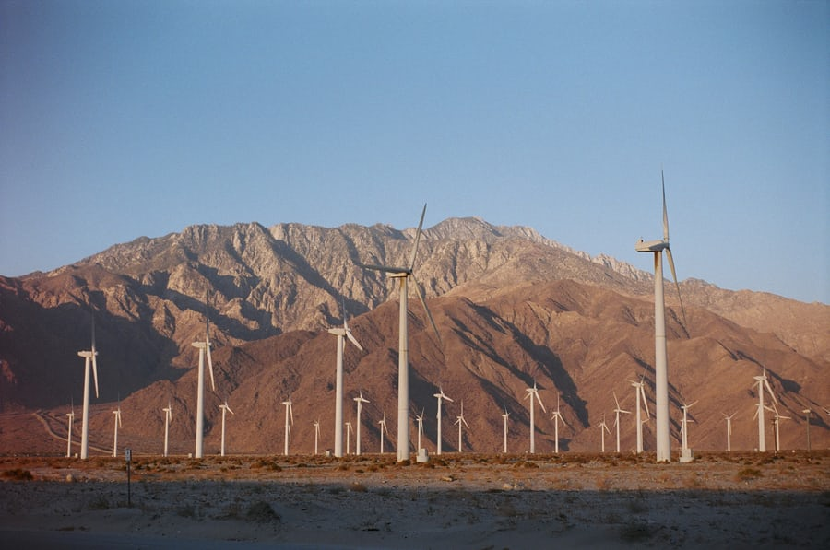
Wind turbines

Slide 5
- REDUCES CONSUMPTION OF FOSSIL FUELS FOR ELECTRICITY PRODUCTION
- REDUCES PRODUCTION OF GREENHOUSE GASES
- REDUCES PRODUCTION OF POLLUTION
- WIND IS A RENEWABLE RESOURCE
ADVANTAGES

Slide 6
-WIND GENERATORS ONLY WORK IN CERTAIN AREAS (FOCUS OF PROJECT)
- WIND GENERATORS ARE TALL AND CAN BLOCK VIEWS OF NEARBY SCENERY
- CAN BE NOISY (OUTSIDE OF A MILE YOU CAN’T HEAR THEM)
DISADVANTAGES

Slide 7
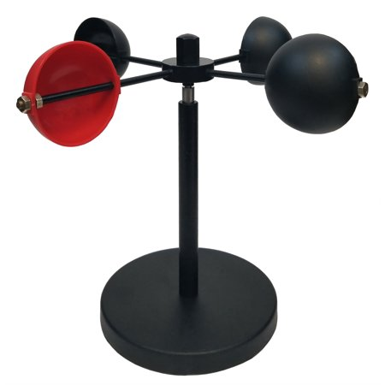
ANEMOMETER
THE ANEMOMETERS THAT ENGINEERS DESIGN ARE CRITICAL INSTRUMENTS FOR WIND-POWER GENERATORS
POWER GENERATED IS NOT A LINEAR RELATIONSHIP
THEREFOR IT’S IMPORTANT TO PUT THEM IN THE RIGHT LOCATIONS

Slide 8
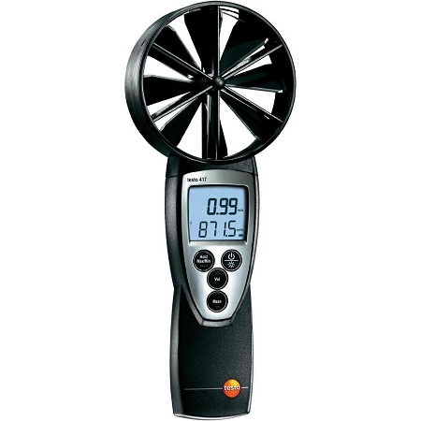

Slide 9
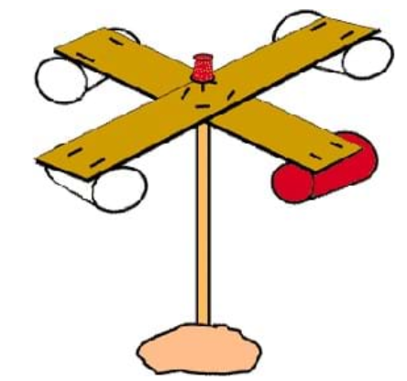
WHAT WE’LL BUILD TODAY

